Slide 1

CLASS 11 CD-404 Variables and Its Types UNIT 2
Variables and Its Types
Prof. Vineeta Shrivastava
Assistant Professor
Department of Computer Science & Engineering
LNCT-E, Bhopal
Lakshmi Narain College of Technology Excellence, Bhopal

Slide 2
CLASS 11 CD-404 Variables and Its Types UNIT 2
AGENDA
Variables
Types of variables
Numerical variables and its types
Categorical Variables & its types
Date Time & Mixed Variables
Prof. Vineeta Shrivastava
Assistant Professor
Department of Computer Science & Engineering
LNCT-E, Bhopal
Lakshmi Narain College of Technology Excellence, Bhopal

Slide 3
CLASS 11 CD-404 Variables and Its Types UNIT 2
What is a variable?
A variable is any character, data or quantity that can be measures or counted.
Types of Variables
Numerical
Categorical
Data & Time
Mixed
Prof. Vineeta Shrivastava
Assistant Professor
Department of Computer Science & Engineering
LNCT-E, Bhopal
Lakshmi Narain College of Technology Excellence, Bhopal

Slide 4
CLASS 11 CD-404 Variables and Its Types UNIT 2
Numerical Variable
Discrete
Continuous
Categorical Variable
Ordinal
Nominal
Prof. Vineeta Shrivastava
Assistant Professor
Department of Computer Science & Engineering
LNCT-E, Bhopal
Lakshmi Narain College of Technology Excellence, Bhopal

Slide 5
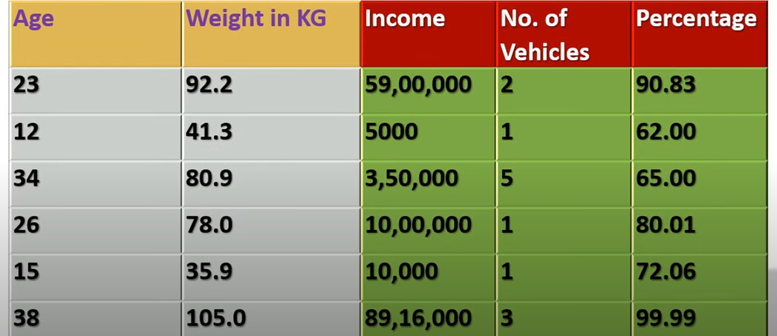
CLASS 11 CD-404 Variables and Its Types UNIT 2
What is numerical variable
A numerical variable is a variable where the measurement or number has a numerical meaning.
Prof. Vineeta Shrivastava
Assistant Professor
Department of Computer Science & Engineering
LNCT-E, Bhopal
Lakshmi Narain College of Technology Excellence, Bhopal

Slide 6
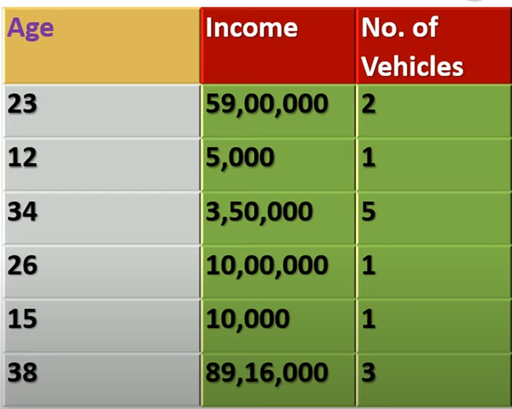
CLASS 11 CD-404 Variables and Its Types UNIT 2
What is Discrete variable?
The value which can be counted as whole value or fixed value are called discrete variables
Eg 1,5,17,45,100
Not 5.2,7.5
Prof. Vineeta Shrivastava
Assistant Professor
Department of Computer Science & Engineering
LNCT-E, Bhopal
Lakshmi Narain College of Technology Excellence, Bhopal

Slide 7
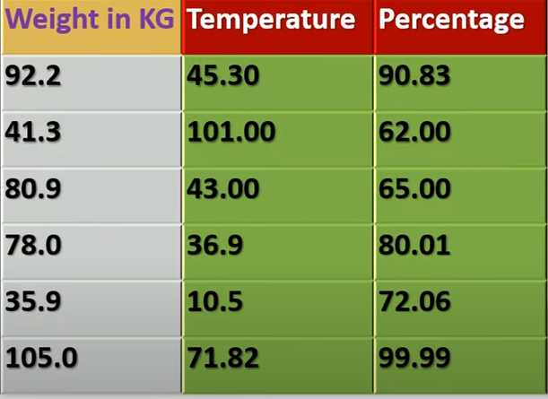
CLASS 11 CD-404 Variables and Its Types UNIT 2
What is Continuous variable ?
The value contain range,measuremnets is called contiguous variable
E.g- 1.3,4.5,6.8, not 12,40,87
Floating value
Prof. Vineeta Shrivastava
Assistant Professor
Department of Computer Science & Engineering
LNCT-E, Bhopal
Lakshmi Narain College of Technology Excellence, Bhopal

Slide 8
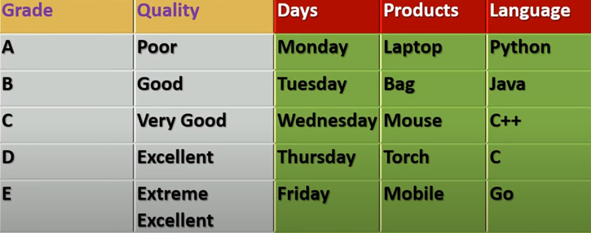
CLASS 11 CD-404 Variables and Its Types UNIT 2
What is Categorical Variables ?
The value of categorical variable are selected from a group of categories, also called as labels.
Types of categorical variable
Ordinal
Nominal
Prof. Vineeta Shrivastava
Assistant Professor
Department of Computer Science & Engineering
LNCT-E, Bhopal
Lakshmi Narain College of Technology Excellence, Bhopal

Slide 9
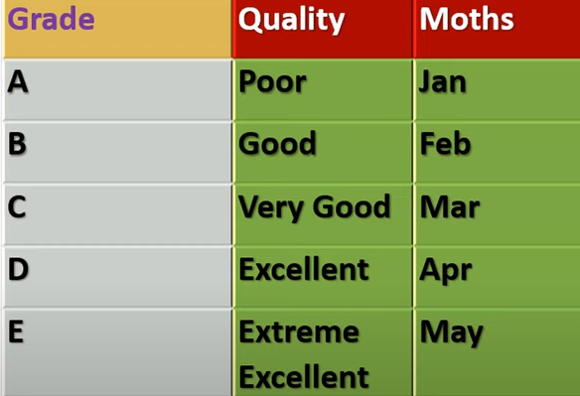
CLASS 11 CD-404 Variables and Its Types UNIT 2
Ordinal Variable
Ordinal variables are categorical variable in which categories can be meaningfully ordered.
When the ordinal variables convert into a number then it has mathematical value.
E.g. Rating of product
Prof. Vineeta Shrivastava
Assistant Professor
Department of Computer Science & Engineering
LNCT-E, Bhopal
Lakshmi Narain College of Technology Excellence, Bhopal

Slide 10
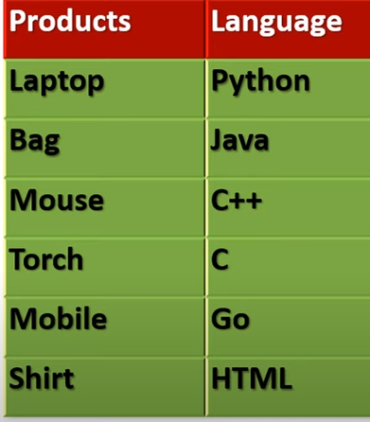
CLASS 11 CD-404 Variables and Its Types UNIT 2
Nominal Variable
Nominal variable is same like ordinal variable but there is noting that indicates an intrinsic order of the labels and in principles.
All labels are equal no order.
No mathematical value
Eg colour: red,blue,green,yellow
Prof. Vineeta Shrivastava
Assistant Professor
Department of Computer Science & Engineering
LNCT-E, Bhopal
Lakshmi Narain College of Technology Excellence, Bhopal

Slide 11
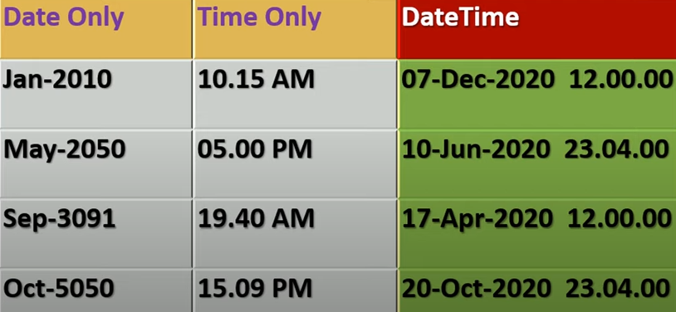
CLASS 11 CD-404 Variables and Its Types UNIT 2
Date and Time
Date and time variable contain date only, time only or date and time both.
Eg app login ,log out, birth time , death time, money withdraw.
Prof. Vineeta Shrivastava
Assistant Professor
Department of Computer Science & Engineering
LNCT-E, Bhopal
Lakshmi Narain College of Technology Excellence, Bhopal

Slide 12
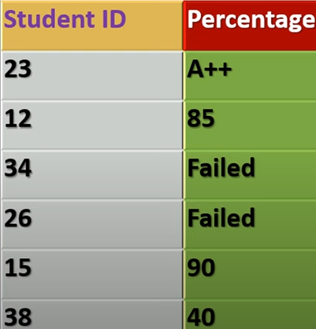
CLASS 11 CD-404 Variables and Its Types UNIT 2
Mixed Variable ?
The variable which contains numbers and categories (labels) is called mixed variables.
Prof. Vineeta Shrivastava
Assistant Professor
Department of Computer Science & Engineering
LNCT-E, Bhopal
Lakshmi Narain College of Technology Excellence, Bhopal

Slide 13
CLASS 11 CD-404 Variables and Its Types UNIT 2
THANKYOU
Prof. Vineeta Shrivastava
Assistant Professor
Department of Computer Science & Engineering
LNCT-E, Bhopal
Lakshmi Narain College of Technology Excellence, Bhopal

